Slide 1
Safety-critical Control in Mixed Criticality Embedded Systems
A Study of Mixed Criticality in the Automotive Industry

Slide 2
Presentation outline
Background
Research question and problem statement
Implementation
Results
Conclusion
Future work

Slide 3
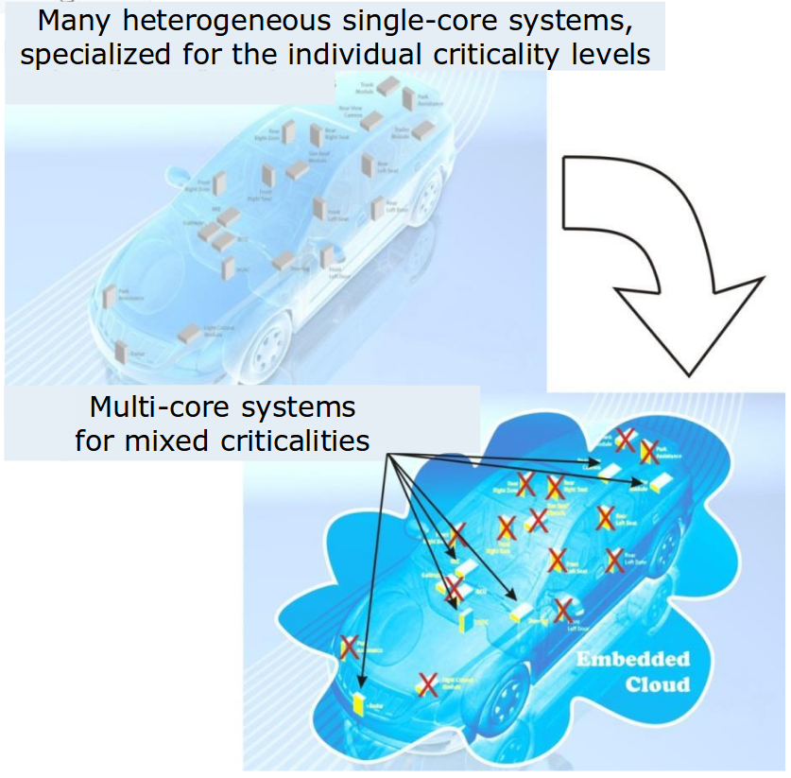
Background
Today, modern cars have approximately 100 ECUs.
Clear separation between functions
Inefficient resource usage
Moving toward MCS would mean:
Efficient resource usage
Difficult to separate functions of different criticality
Illustration of combining applications to reduce ECUs [1].

Slide 4
ISO 26262
Four different Automotive Safety Integrity Levels, ASILs
[3] Road vehicles – functional safety – part 9: Automotive safety integrity level (asil)-oriented and safety-oriented analyses. Standard, International Organization for Standardization, Geneva, CH, November 2011.

Slide 5
Schedulers
Steve Vestal showed that neither RM nor DM was optimal when criticality levels are introduced.
Sanjoy Baruah and steve Vestal showed that EDF does not dominate FP in mixed criticality systems.

Slide 6
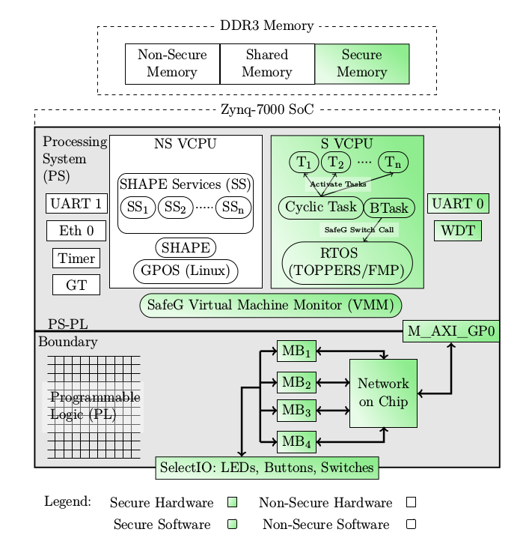
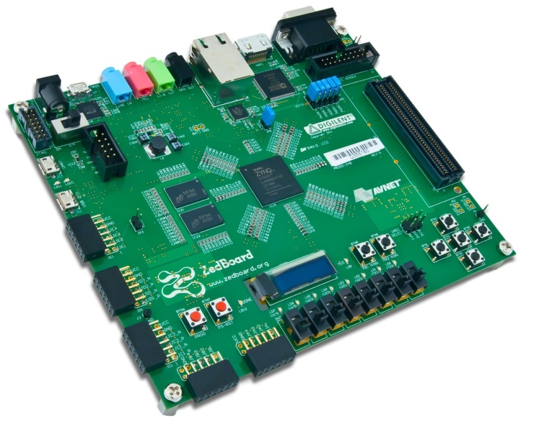
Alten MCS
Alten MCS overview [3]

Slide 7
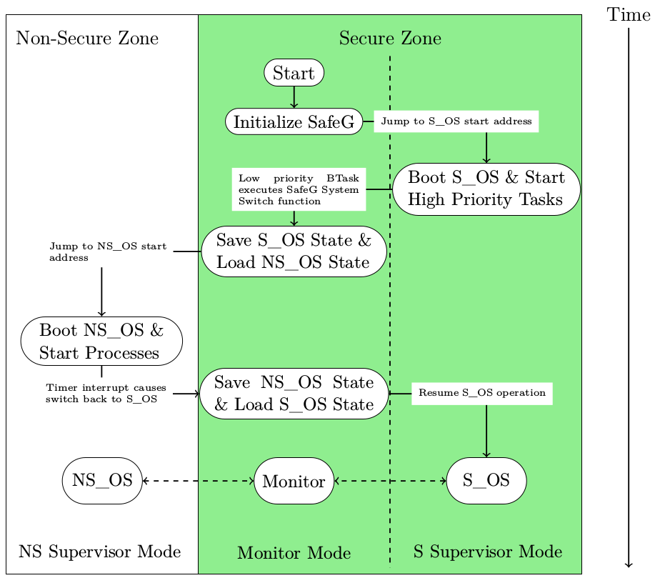
Alten MCS – Processor switching state
Processor boot sequence [3]

Slide 8
Alten MCS – Processor switching state
Mode switch takes ~2 us
Theroretical maximum frequency of 250 kHz.

Slide 9
Research question
Is virtualization an efficient approach when trying to reconcile
the conflicting requirements of partitioning for safety assurance and sharing for efficient resource usage when implementing a safety-critical control system?

Slide 10
Problem statement
Implement the safety-critical applications required for platooning on a mixed criticality system and evaluate the performance of the processor in terms of
Missed deadlines?
Robustness of hypervisor
CPU utilization

Slide 11
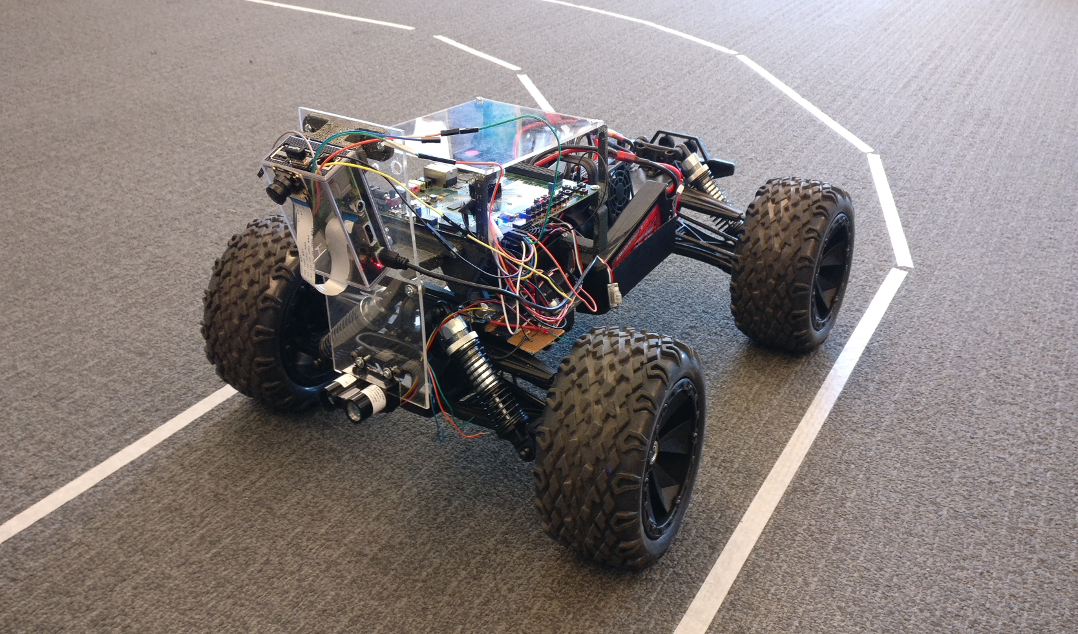
System overview

Slide 12
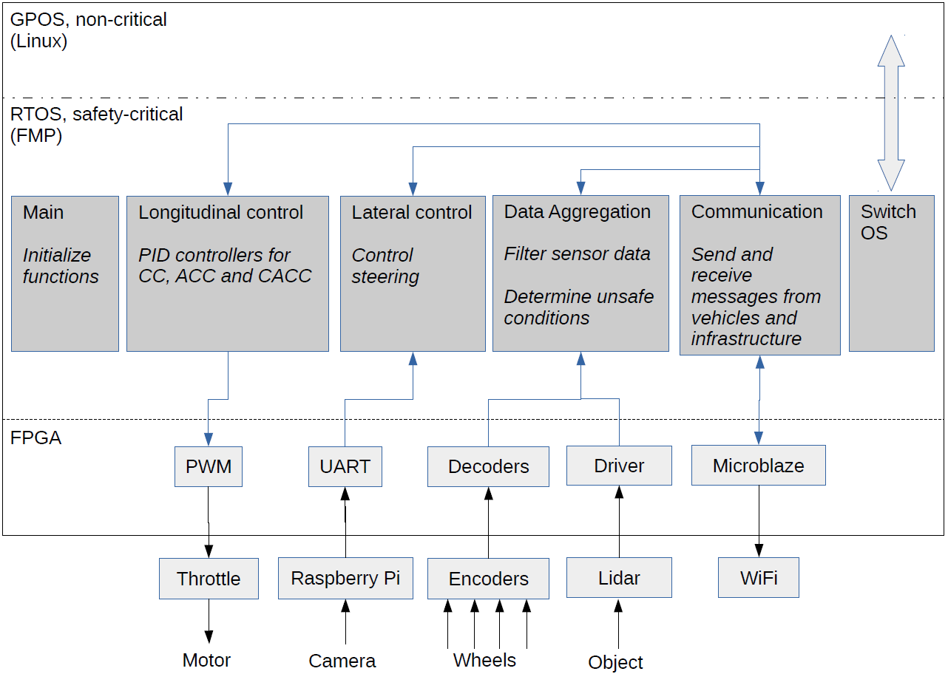
System overview

Slide 13
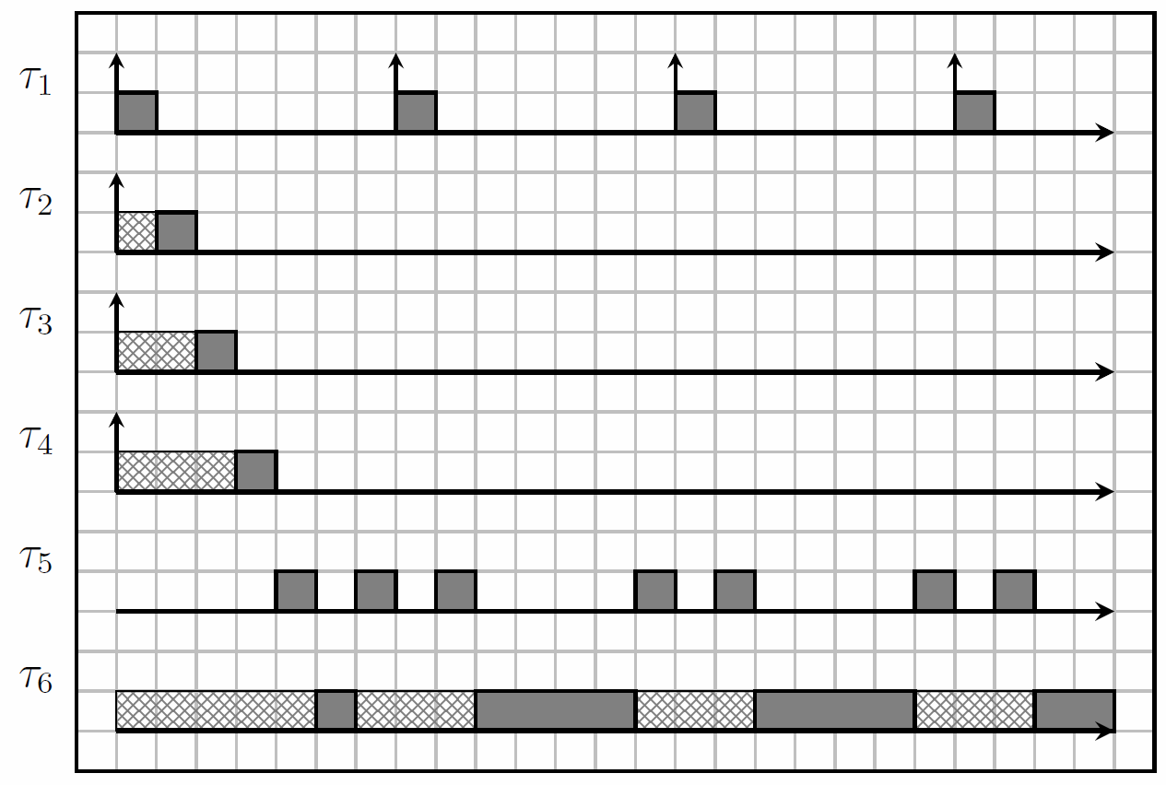
Processor scheduling
Data aggregation
Communication
Lateral control
Longitudinal control
OS switch
GPOS

Slide 14
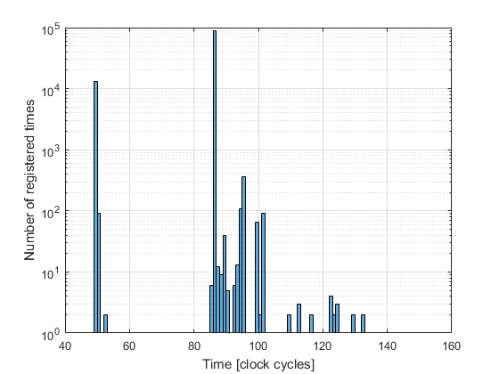
OS switch execution times
WCET
153 clock cycles
3.06 us
Median execution time
86 clock cycles
1.72 us
1 kHz switching frequency:
RTOS CPU utilization 0.005%
Hypervisor overhead 0.6%
Increased total CPU utilization to potentially 99.4%

Slide 15
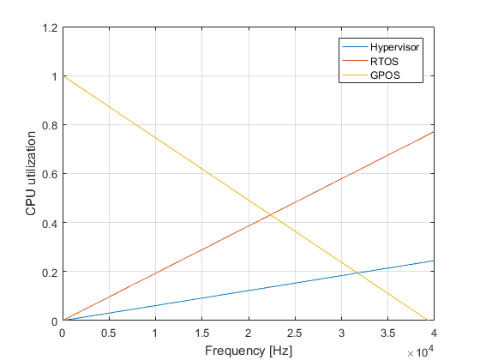
CPU utilization

Slide 16
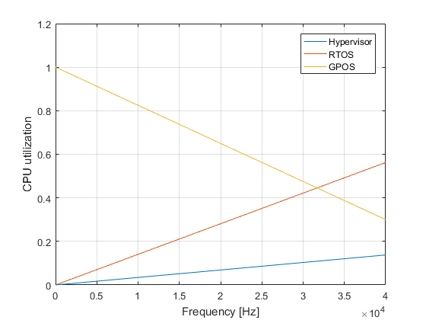
CPU utilization

Slide 17
Conclusion
Safe (only as safe as the hypervisor)
Efficient
Efficient in the industry as a whole?

Slide 18
Future work
Robustness of the hypervisor must be tested extensively.
Experiments with systems of more criticality levels
How many criticality levels would be necessary?
Calculate more accurately the financial effects of MCS

Slide 19
Questions?
Sources:
[1] https://www.artemis-emc2.eu/project_overview/ll1_automotive_applications/
[2] Road vehicles – functional safety – part 9: Automotive safety integrity level (asil)-oriented and safety-oriented analyses. Standard, International Organization for Standardization, Geneva, CH, November 2011.
[3] Youssef Zaki. An embedded multi-core platform for mixed-criticality systems: Study and analysis of virtualization techniques. Master’s thesis, KTH, School of Information and communication Technology (ICT), 2016.
[4] Alan Burns and Robert I. Davis. Mixed criticality systems - a review. July 2016
[5] Steve Vestal. Preemptive scheduling of multi-criticality systems with varying degrees of execution time assurance, 2007.
[6] Sanjoy Baruah and Steve Vestal. Schedulability analysis of sporadic tasks with multiple criticality specifications, 2008.

